Slide 1
LEDAkem and LEDApkc
Presented by Ray Perlner

Slide 2
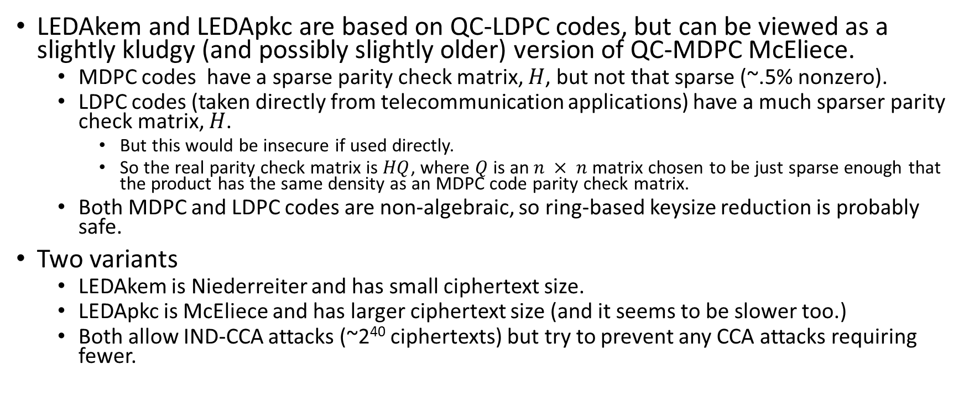
High Level Summary
LEDAkem and LEDApkc are based on QC-LDPC codes, but can be viewed as a slightly kludgy (and possibly slightly older) version of QC-MDPC McEliece.
  MDPC codes have a sparse parity check matrix, $H$, but not that sparse (~.5% nonzero).
  LDPC codes (taken directly from telecommunication applications) have a much sparser parity check matrix, $H$.
    But this would be insecure if used directly.
    So the real parity check matrix is $HQ$, where $Q$ is an $n × n$matrix chosen to be just sparse enough that the product has the same density as an MDPC code parity check matrix.
  Both MDPC and LDPC codes are non-algebraic, so ring-based keysize reduction is probably safe.
Two variants
  LEDAkem is Niederreiter and has small ciphertext size.
  LEDApkc is McEliece and has larger ciphertext size (and it seems to be slower too.)
  Both allow IND-CCA attacks (~2⁴⁰ ciphertexts) but try to prevent any CCA attacks requiring fewer.

Slide 3
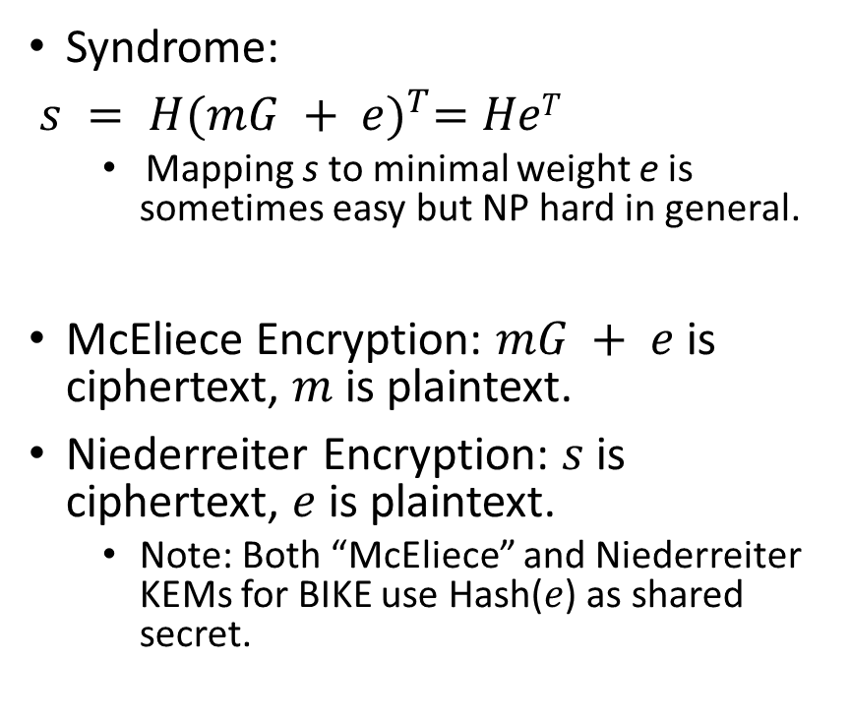
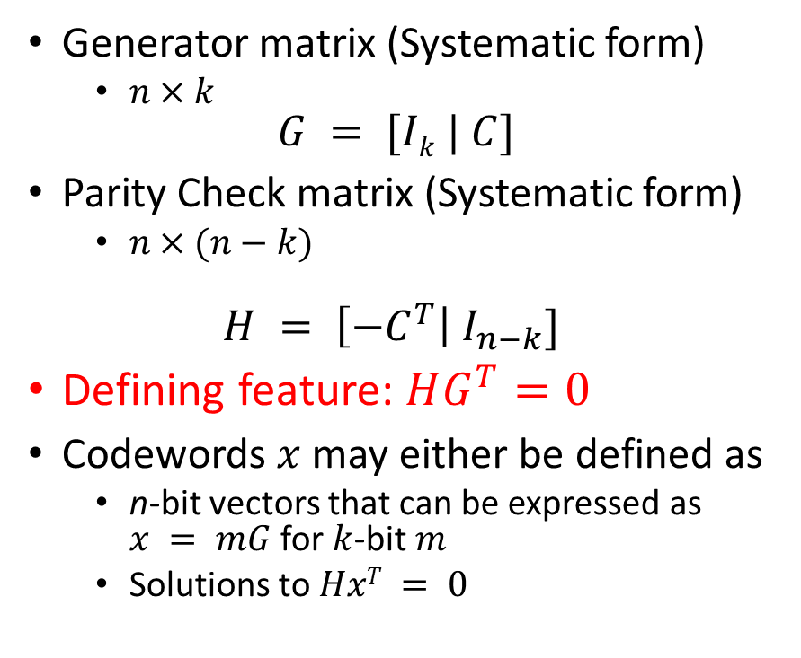
Some Coding Theory
Generator matrix (Systematic form)
  $n×k$
$$G = [Ik | C]$$
Parity Check matrix (Systematic form)
  $n×(n−k)$
$$H = \left[{−C}^{T}\right| I_{n−k}]$$
Defining feature: $HG^{T}=0$
Codewords $x$ may either be defined as
  n-bit vectors that can be expressed as $x = mG$ for $k$-bit $m$
  Solutions to $HxT = 0$
Syndrome:
$s = H{(mG + e)}^{T}=HeT$
  Mapping s to minimal weight e is sometimes easy but NP hard in general.
McEliece Encryption: $mG + e$is ciphertext, $m$ is plaintext.
Niederreiter Encryption: $s$ is ciphertext, $e$ is plaintext.
  Note: Both “McEliece” and Niederreiter KEMs for BIKE use Hash($e$) as shared secret.

Slide 4
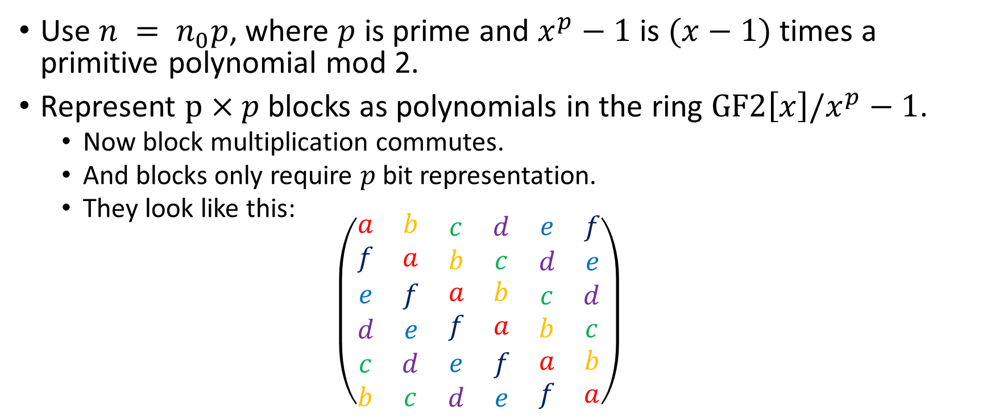
Quasi-Cyclic structure
Use $n = n_{0}p$, where $p$ is prime and $x^{p}−1$ is $(x−1)$times a primitive polynomial mod 2.
Represent $p×p$blocks as polynomials in the ring $GF2\left[x\right]/x^{p}−1$.
  Now block multiplication commutes.
  And blocks only require $p$ bit representation.
  They look like this:
  $$\left(\begin{matrix}\begin{matrix}a & b \\ f & a\end{matrix} & \begin{matrix}c & d \\ b & c\end{matrix} & \begin{matrix}e & f \\ d & e\end{matrix} \\ \begin{matrix}e & f \\ d & e\end{matrix} & \begin{matrix}a & b \\ f & a\end{matrix} & \begin{matrix}c & d \\ b & c\end{matrix} \\ \begin{matrix}c & d \\ b & c\end{matrix} & \begin{matrix}e & f \\ d & e\end{matrix} & \begin{matrix}a & b \\ f & a\end{matrix}\end{matrix}\right)$$

Slide 5
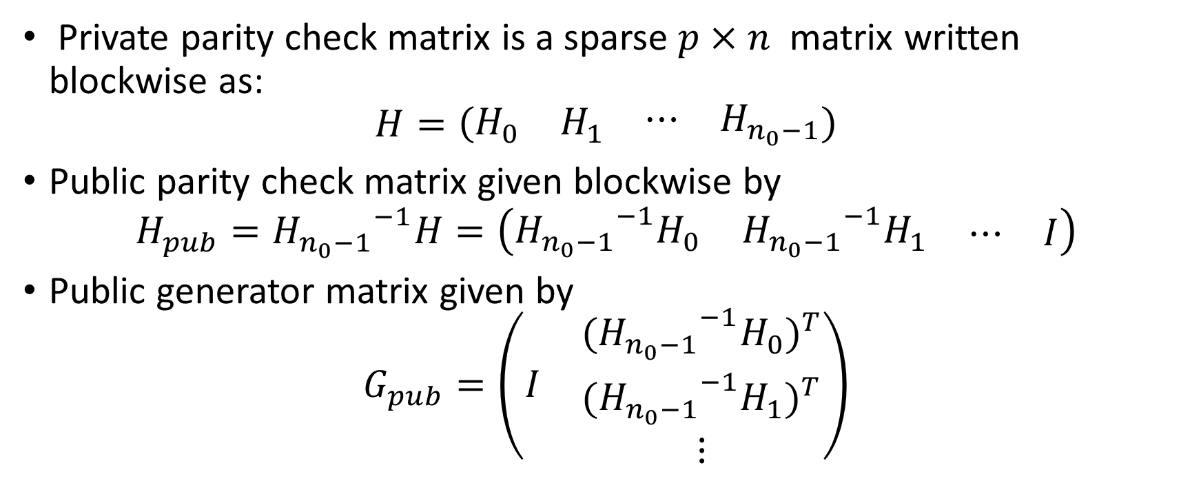
QC-MDPC codes
Private parity check matrix is a sparse $p×n$ matrix written blockwise as:
$$H=\left(\begin{matrix}\begin{matrix}H_{0} & H_{1}\end{matrix} & \begin{matrix}⋯ & H_{n_{0}−1}\end{matrix}\end{matrix}\right)$$
Public parity check matrix given blockwise by
$$H_{pub}={H_{n_{0}−1}}^{−1}H=\left(\begin{matrix}\begin{matrix}{{H_{n_{0}−1}}^{−1}H}_{0} & {{H_{n_{0}−1}}^{−1}H}_{1}\end{matrix} & \begin{matrix}⋯ & I\end{matrix}\end{matrix}\right)$$
Public generator matrix given by
$$G_{pub}=\left(\begin{matrix}I & \begin{matrix}{{{{(H}_{n_{0}−1}}^{−1}H}_{0})}^{T} \\ {{{{(H}_{n_{0}−1}}^{−1}H}_{1})}^{T} \\ ⋮\end{matrix}\end{matrix}\right)$$

Slide 6
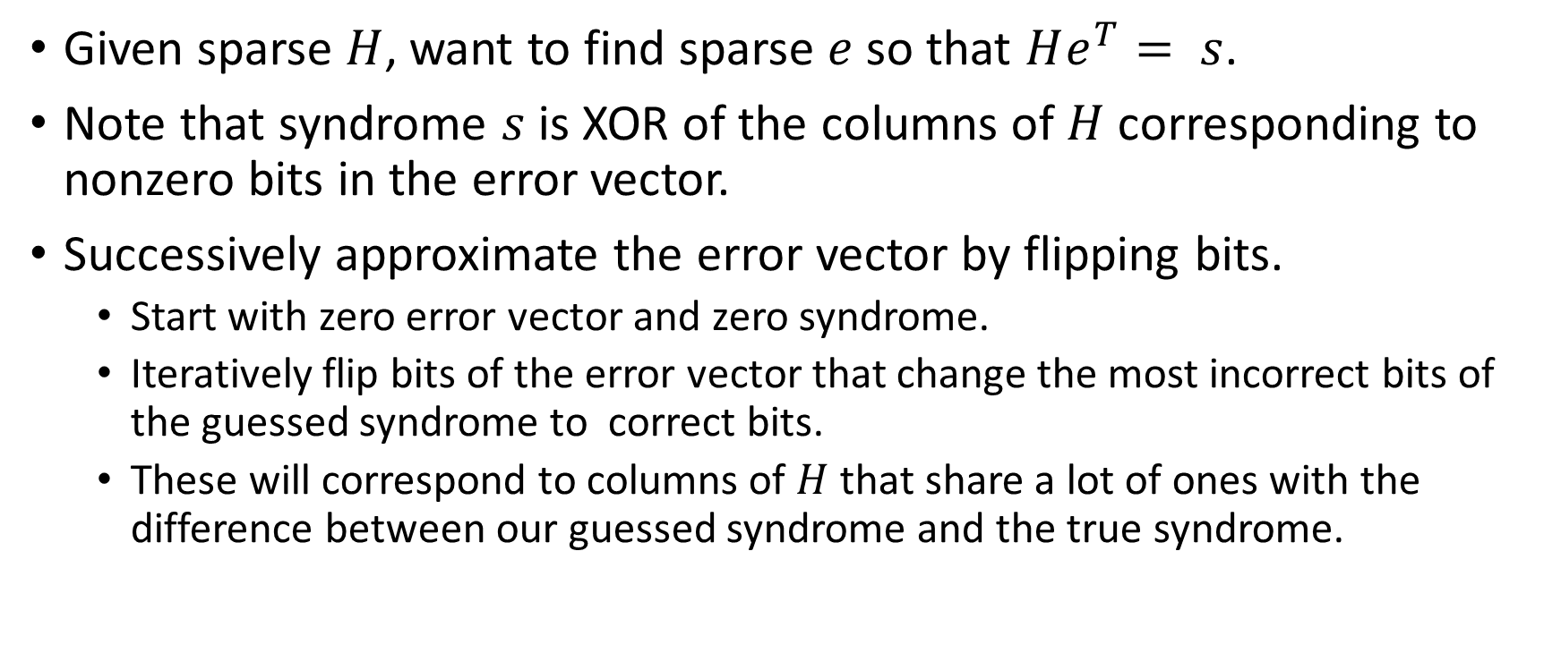
Bitflip decoding
Given sparse $H$, want to find sparse $e$ so that $He^{T}= s$.
Note that syndrome $s$ is XOR of the columns of $H$ corresponding to nonzero bits in the error vector.
Successively approximate the error vector by flipping bits.
  Start with zero error vector and zero syndrome.
  Iteratively flip bits of the error vector that change the most incorrect bits of the guessed syndrome to correct bits.
  These will correspond to columns of $H$ that share a lot of ones with the difference between our guessed syndrome and the true syndrome.

Slide 7

The construction of the matrix HQ in LEDAxxx
Use LDPC code parity check matrix $H$ with column weight $d_{v}$.
Right multiply by a $n×n$ matrix $Q$ whose column/row weights can be given blockwise as ($m$_{xxx} chosen to guarantee last block of HQ invertible):
Use the product $HQ$ instead of $H$ in the QC-MDPC construction from slide 5.

Slide 8
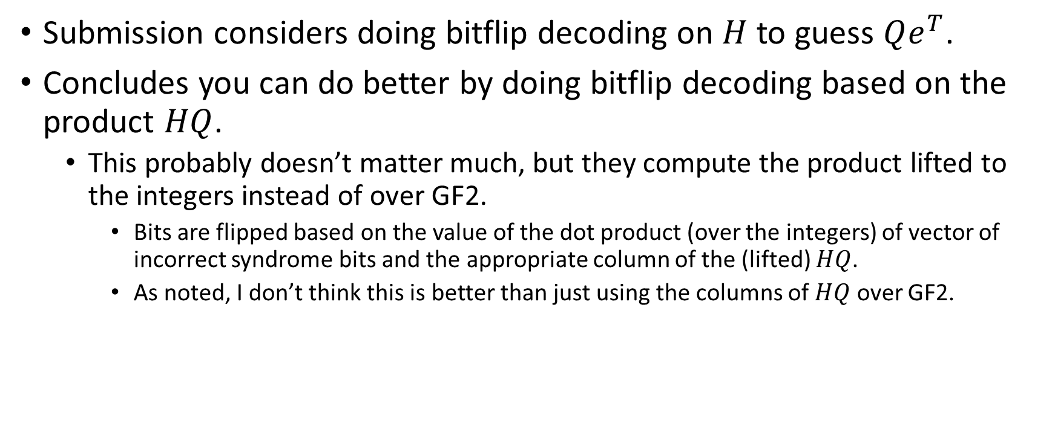
Bitflip decoding for HQ
(Q decoding)
Submission considers doing bitflip decoding on $H$ to guess $Qe^{T}$.
Concludes you can do better by doing bitflip decoding based on the product $HQ$.
  This probably doesn’t matter much, but they compute the product lifted to the integers instead of over GF2.
    Bits are flipped based on the value of the dot product (over the integers) of vector of incorrect syndrome bits and the appropriate column of the (lifted) $HQ$.
    As noted, I don’t think this is better than just using the columns of $HQ$ over GF2.

Slide 9
Attacks
Reaction attacks
Information set decoding

Slide 10
Reaction attacks
LEDAxxx has an appreciable decryption failure rate
FHSZGJ17 showed how to recover statistical information on private key from decryption failures (Similar to GJS attack on QC-MDPC/BIKE)

Slide 11
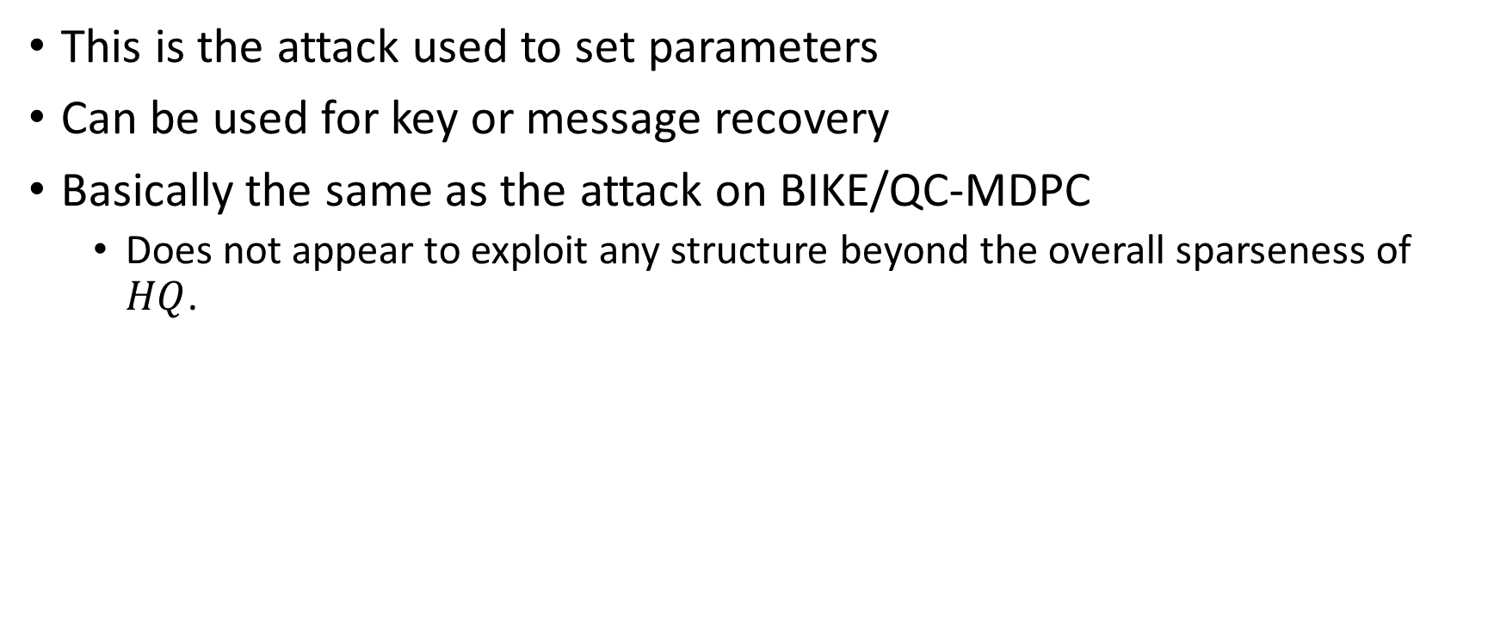
Information set decoding
This is the attack used to set parameters
Can be used for key or message recovery
Basically the same as the attack on BIKE/QC-MDPC
  Does not appear to exploit any structure beyond the overall sparseness of $HQ$.

Slide 12
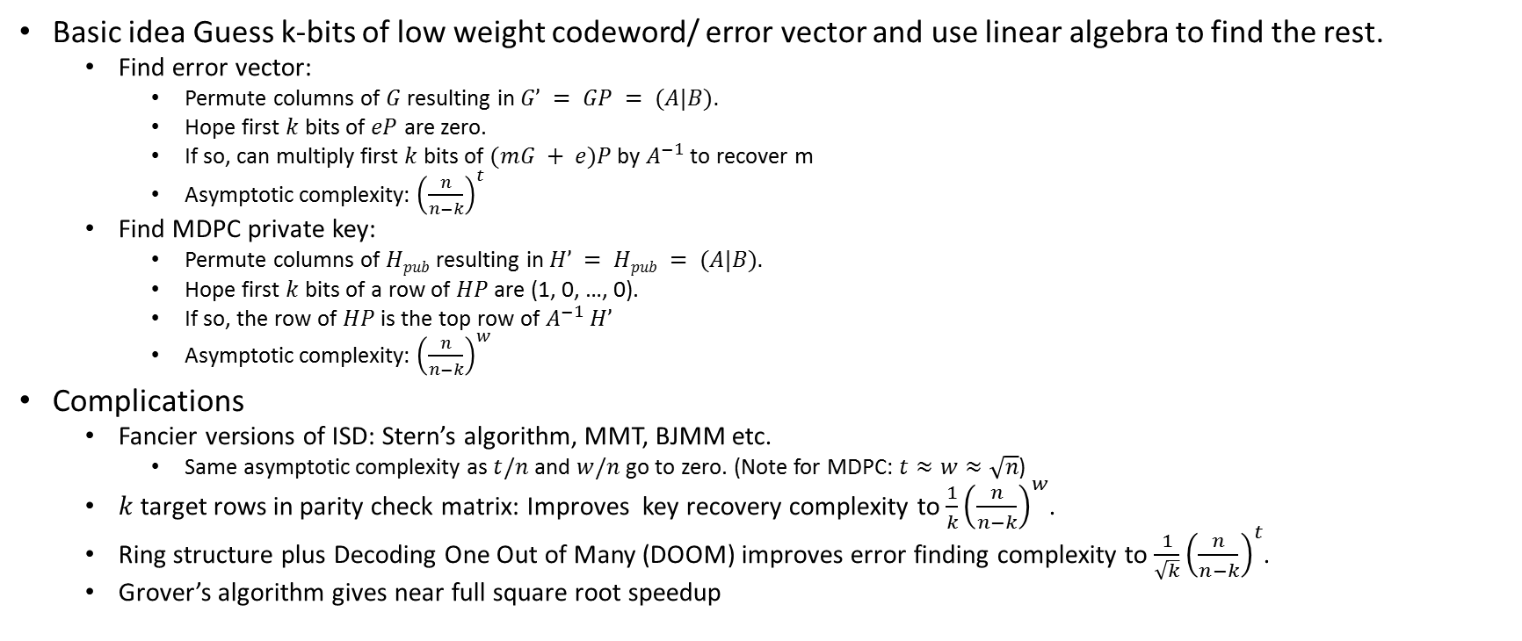
Known attacks: Information Set Decoding
(Taken directly from my BIKE presentation)
Basic idea Guess k-bits of low weight codeword/ error vector and use linear algebra to find the rest.
  Find error vector:
    Permute columns of $G$ resulting in $G’ = GP = (A|B).$
    Hope first $k$ bits of $eP$ are zero.
    If so, can multiply first $k$ bits of $(mG + e)P$by $A^{−1}$ to recover m
    Asymptotic complexity: ${\left(\frac{n}{n−k}\right)}^{t}$
  Find MDPC private key:
    Permute columns of $Hpub$ resulting in $H’ = Hpub = (A|B).$
    Hope first $k$ bits of a row of $HP$ are (1, 0, …, 0).
    If so, the row of $HP$ is the top row of $A^{−1}$ $H’$
    Asymptotic complexity: ${\left(\frac{n}{n−k}\right)}^{w}$
Complications
  Fancier versions of ISD: Stern’s algorithm, MMT, BJMM etc.
    Same asymptotic complexity as $t/n$ and $w/n$ go to zero. (Note for MDPC: $t≈w≈\sqrt{n}$)
  $k$ target rows in parity check matrix: Improves key recovery complexity to $\frac{1}{k}{\left(\frac{n}{n−k}\right)}^{w}$.
  Ring structure plus Decoding One Out of Many (DOOM) improves error finding complexity to $\frac{1}{\sqrt{k}}{\left(\frac{n}{n−k}\right)}^{t}$.
  Grover’s algorithm gives near full square root speedup

Slide 13
Parameters

Slide 14
Key Sizes

Slide 15
Performance

Slide 16
Attack costs: ISD

Slide 17
Advantages and limitations
Basically same as QC-MDPC/BIKE
  Advantages:
    Pretty small key size (not quite as small as Rank or Lattice)
    All known CPA attacks are well understood ISD type attacks, relying on algorithms that haven’t gotten much better against parameters in this range since 1962.
  Disadvantages
    Needs ring structure to get a reasonable key size
    Decryption failures/ CCA attacks
Different from QC-MDPC/BIKE
  Doesn’t suffer from maliciously chosen ciphertext attacks like BIKE
    Attacker needs 2⁴⁰ instead of 2¹³ plaintexts for message recovery
    Fixing this (if needed) would only require superficial changes to BIKE
    Misuse resilience
  Has more structure than QC-MDPC/BIKE
    Not clear if this can be exploited by attacks, but also has no clear benefit.
  Older than QC-MDPC/BIKE
    The insecure versions are definitely older. I think the secure version is slightly older as well.

